Slide 1
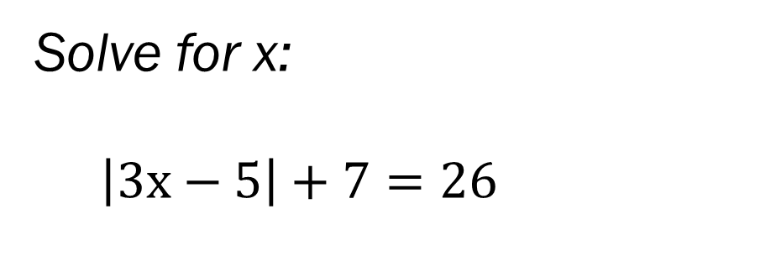
Bell Work
Solve for x:
$\left|3x−5\right|+7=26$
Solve for x:
12 > 4|2x+7|

Slide 2
From Last Time…
New Material
Page 45 #2-5, 29, 45, 65
Mixed Review
Page 48 #96, 99

Slide 3
ALGEBRA 3
Day 11

Slide 4
Chapter 2 Section 3 Linear Equations
Objective: To write, graph, and solve linear equations

Slide 5
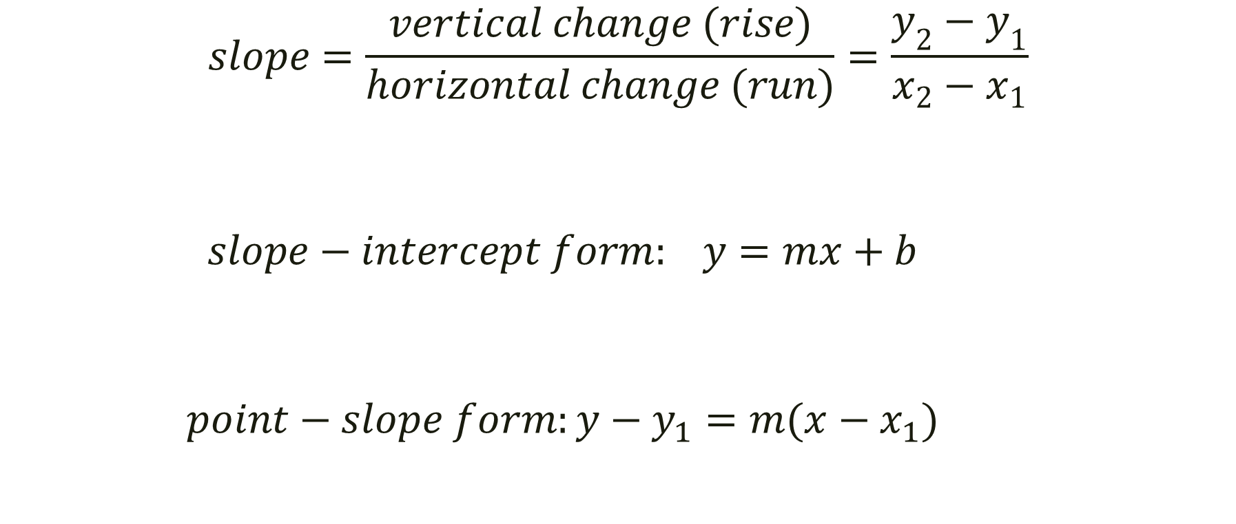
Linear Function Formulas
$$slope=\frac{vertical change (rise)}{horizontal change (run)}=\frac{y_{2}−y_{1}}{x_{2}−x_{1}}$$
$$slope−intercept form: y=mx+b$$
$$point−slope form:y−y_{1}=m(x−x_{1})$$

Slide 6
Don’t Memorize Them, Apply Them
Given the following two points, find the slope, write the equation, and identify the x and y intercepts.
(-6, 4) and (-2, -12)

Slide 7
What else could they ask us?
Given: (-6, 4) and (-2, -12)

Slide 8
What else could they ask us?
Given: (-6, 4) and (-2, -12)
What is the distance between (how far apart are they) these two points?
What is the midpoint of these two points?
Graph.

Slide 9
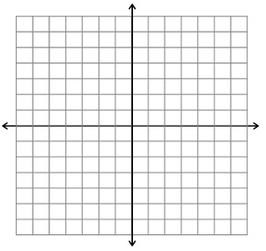
Graph the following. Is it a function?
4y – 2x = –12

Slide 10
Quick Check for Understanding
Describe the slope between the following two special cases.
(4, 2) and (4, -6)
(6, -3) and (-1, -3)

Slide 11
For Next Time…
New Material
Page 78 #4-6, 23, 31, 37, 50
Mixed Review
Page 80 #68, 69, 71

